Slide 1
Can We Predict Energy Consumption?
A Capstone Project by
Michelle Thorne

Slide 2

Overview
Background and Research Question
The Data
Data Investigation
The Models
Summary

Slide 3
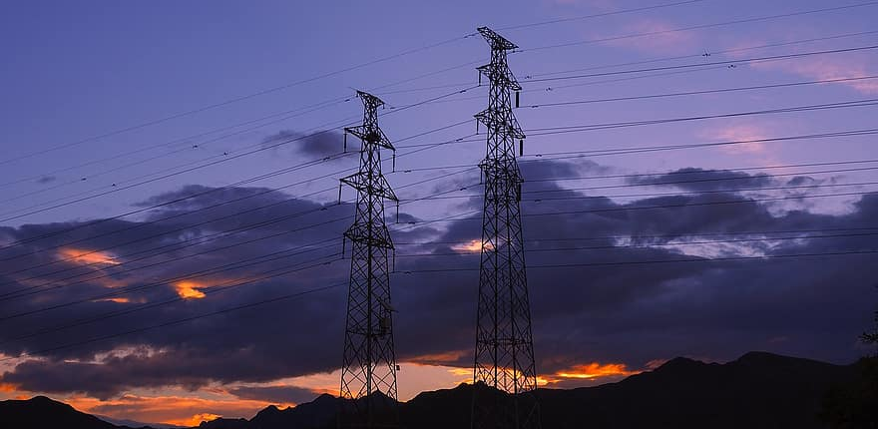
Background
Energy Forecasting is important because:
Ensures the stability and reliability of the electrical grid
Helps to predict market prices

Slide 4


Background
Energy Demand depends on many factors:
Weather:
Temperature
Wind speed
Precipitation
Business and day to day activities:
On-peak/Off-peak times
Weekday vs Weekend
Holidays

Slide 5

Can we Use Average Daily Temperatures to Predict Energy Consumption?

Slide 6

The Data
2 Open Datasets from Kaggle
Hourly Energy Consumption
Daily Temperature of Major Cities

Slide 7
Hourly Energy Consumption
Over 10 years of hourly energy consumption data for PJM in Megawatts
Columns:
Datetime
AEP
COMED
DAYTON
DEOK
DOM
DUQ
EKPC
FE
NI
PJME
PJMW
PJM_LOAD

Slide 8
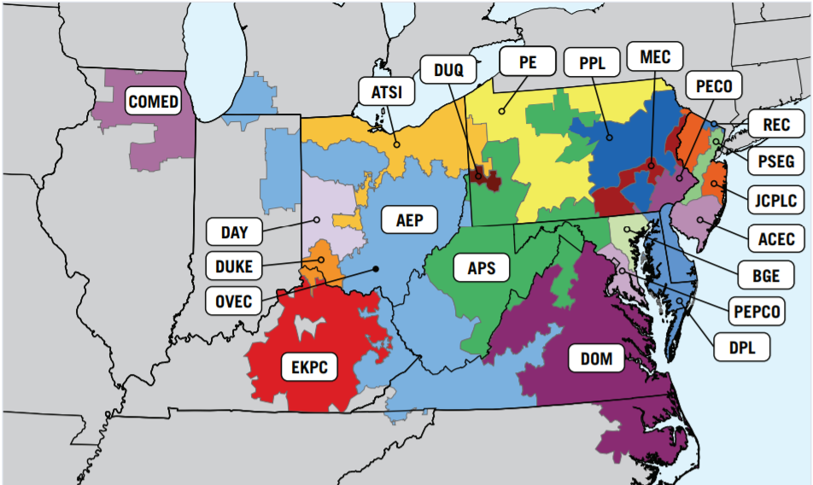
Hourly Energy Consumption
Over 10 years of hourly energy consumption data for PJM in Megawatts

Slide 9
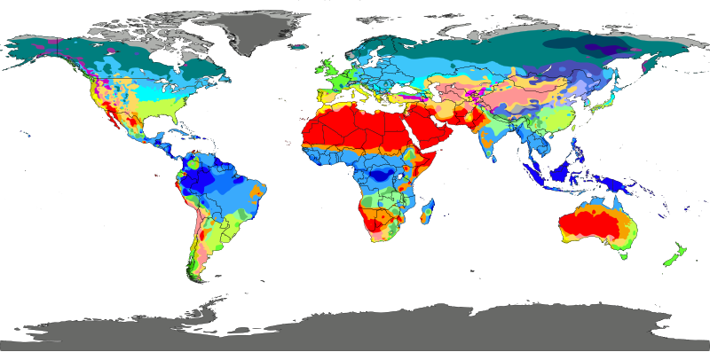
Daily Temperature of Major Cities
Columns:
Region
Country
State
City
Month
Day
Year
AvgTemperature

Slide 10
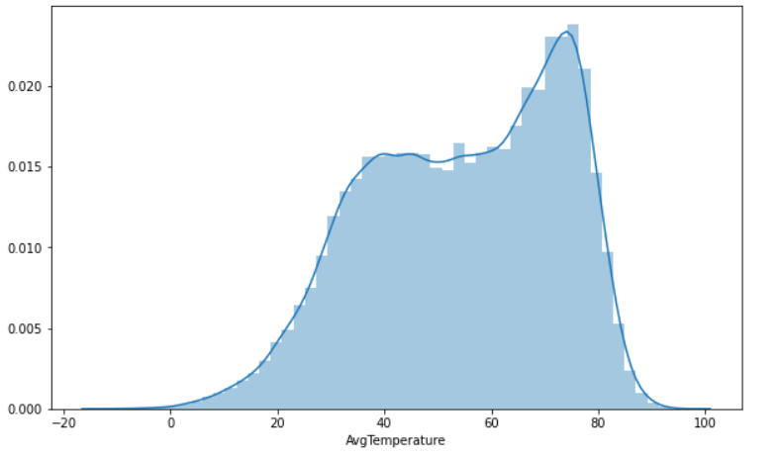
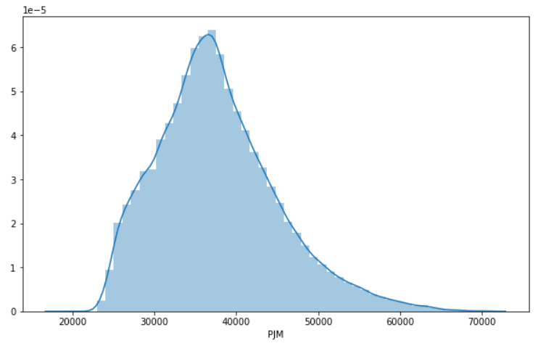
Data Investigation
Distribution of Daily Avg Temps
Distribution of Total Hourly Consumption

Slide 11
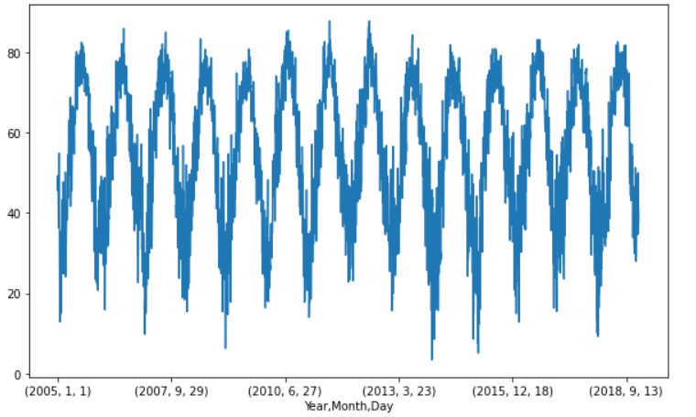
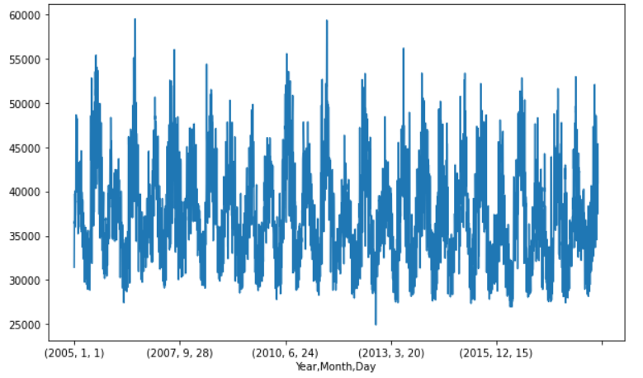
Data Investigation
Daily Avg Temps by Year, Month, Day
Daily Avg Consumption by Year, Month, Day

Slide 12
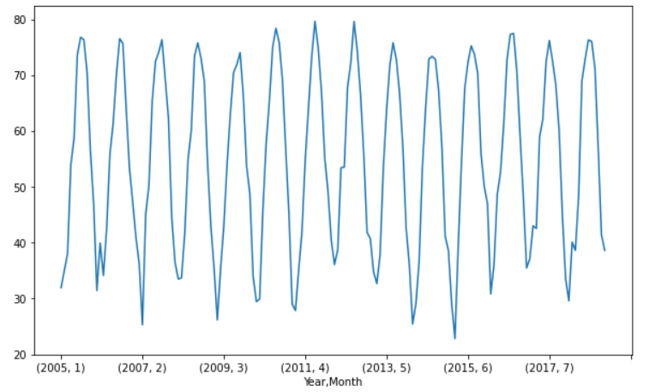
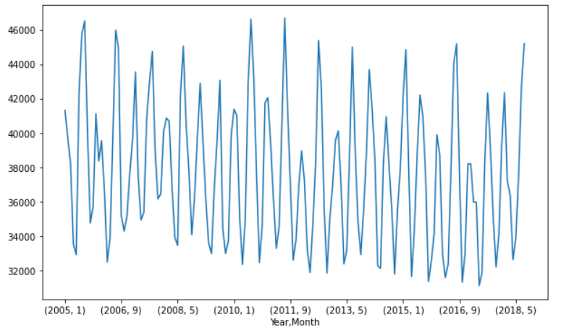
Data Investigation
Daily Avg Temps by Year, Month
Daily Avg Consumption by Year, Month

Slide 13
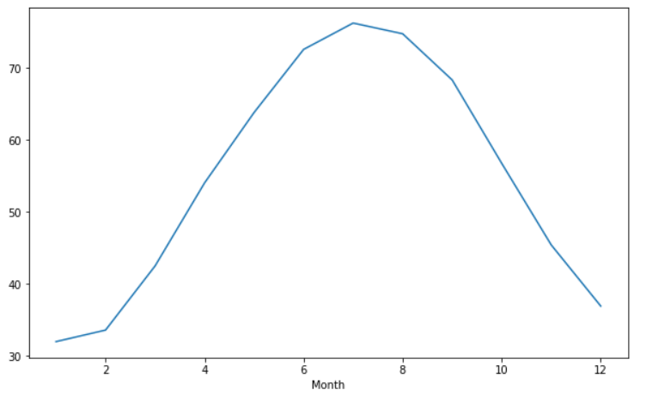
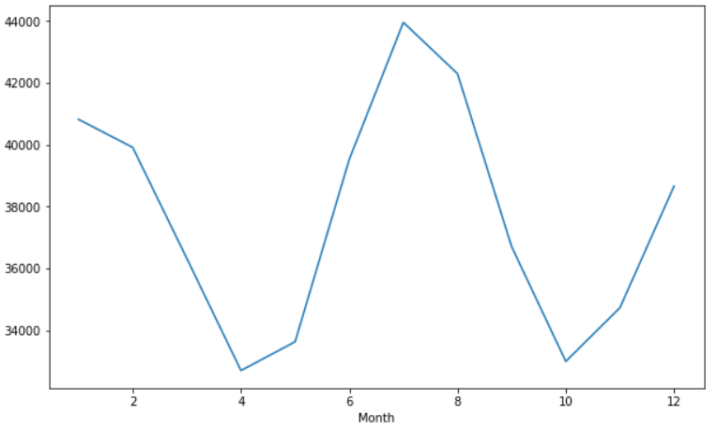
Data Investigation
Daily Avg Temps by Month
Daily Avg Consumption by Month

Slide 14
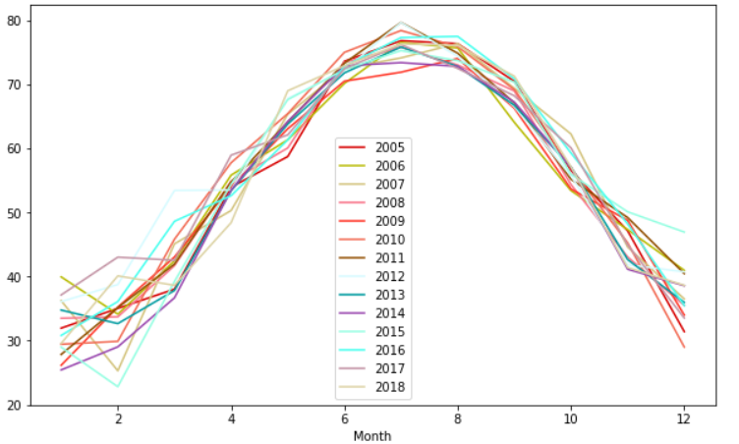
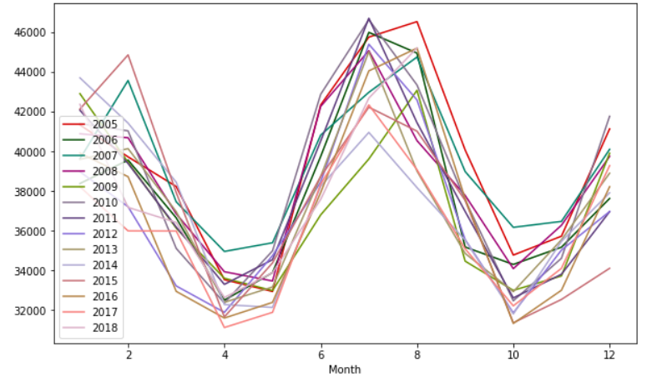
Data Investigation
Daily Avg Temps by Month per Year
Daily Avg Consumption by Month per Year

Slide 15
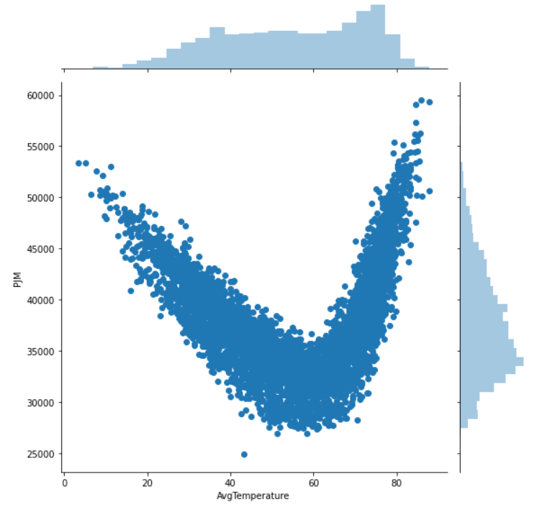
Data Investigation
Overall Correlation:
0.0617 (p<0.05)
Correlation Under 65℉:
-0.8413 (p<0.05)
Correlation Over 65℉:
0.8404 (p<0.05)

Slide 16
Models
Linear Regression -overall adjusted
Split into cold vs. hot:
OLS
OLS adjusted
Ridge Regression
Lasso Regression
Elastic Net Regression

Slide 17

Models
Random Forest
Gradient Boost
KNN

Slide 18

Linear Regression
Overall:
Training Score: 0.6848
Test Score: 0.6655
Mean of Errors: 23.04

Slide 19
Linear Regression (split model-Cold)
Model | R² Training Score | R² Test Score | MAE | MSAE | RMSE | MAPE
Cold | 0.704 | 0.718 | 1977.634 | 6141674.313 | 2478.24 | 5.645
Cold Adj | 0.758 | 0.763 | 1819.202 | 5175649.478 | 2275.01 | 5.224
Cold Ridge | 0.758 | 0.763 | 1818.279 | 5175582.133 | 2274.99 | 5.222
Cold Lasso | 0.758 | 0.763 | 1816.646 | 5177006.22 | 2275.30 | 5.219
Cold Elastic Net | 0.620 | 0.639 | 2212.42 | 7863408.48 | 2804.18 | 6.23

Slide 20
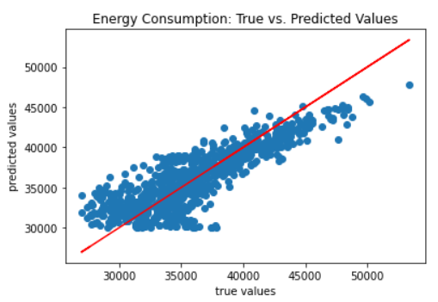
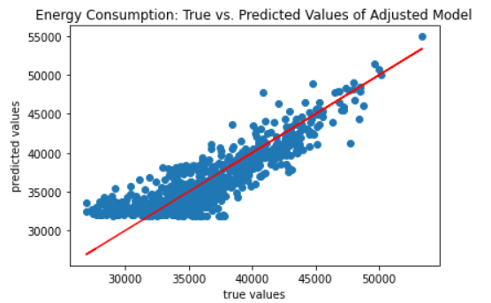
Linear Regression (split model -Cold)

Slide 21
Linear Regression (split model-Hot)
Model | R² Training Score | R² Test Score | MAE | MSAE | RMSE | MAPE
Hot | 0.996 | 0.996 | 252.438 | 119440.90 | 345.60 | 0.627
Hot Adj | 0.715 | 0.708 | 2483.427 | 9465771.01 | 3076.95 | 6.24
Hot Ridge | 0.751 | 0.743 | 2330.47 | 8341161.26 | 2888.11 | 5.85
Hot Lasso | 0.934 | 0.930 | 1203.51 | 2259748.33 | 1503.25 | 2.98
Hot Elastic Net | 0.703 | 0.695 | 2545.94 | 9884433.02 | 3143.95 | 6.37

Slide 22
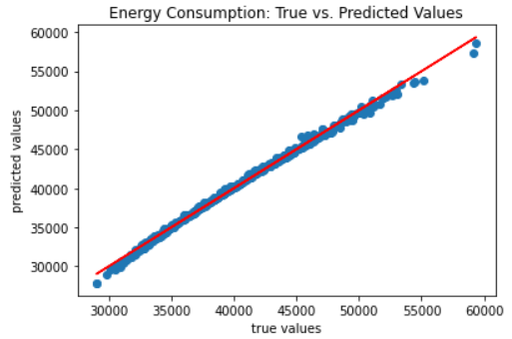
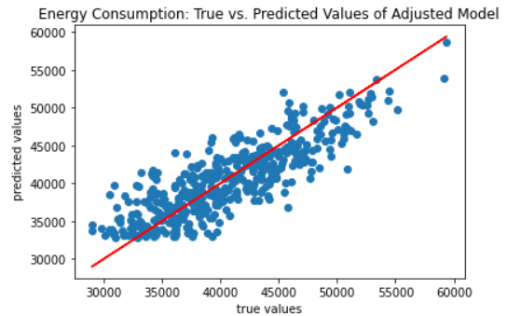
Linear Regression (split model - Hot)

Slide 23
Other Models
Model | Training Score | Test Score
Random Forest N_estimators =100 Max_depth = None | 0.787 | 0.758
Gradient Boost N_estimators = 100 Learning_rate = 0.1 | 0.800 | 0.767
KNN N_neighbors = 5 | 0.807 | 0.756

Slide 24
What’s the Best Model?
Gradient Boost

Slide 25
Summary
Energy Consumption changes based on daily activities and weather changes and seasons throughout the year.
More energy is demanded in colder and hotter parts of the year
Daily Average Temperature is positively correlated with energy consumption above 65 degrees and negatively correlated with energy consumption below 65 degrees
Gradient Boost gave the best prediction fit to the data.

Slide 26
Questions?

